Slide 1
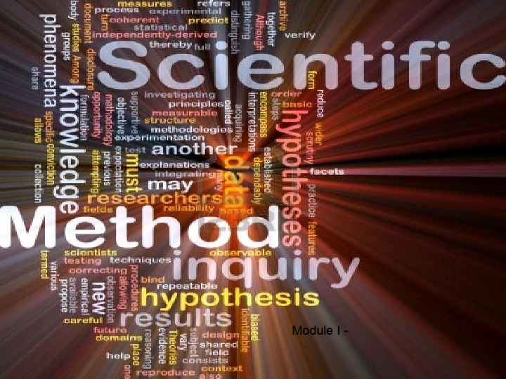
Understanding the
Scientific Method

Slide 2
Science: Modern science endeavors to understand and explain how the natural world works.
Science Is:
1. The study of natural phenomena.
2. Studies that which can be
observed, measured, and tested
by scientific methods.
3. Must utilize our senses to
observe and evaluate.

Slide 3

Science: Endeavors to understand and explain how the natural world works.
Science Is:
4. Based on the assumption that the
universe is orderly, reasonable,
and testable.
5. Used to predict natural events that
may transpire.
6. Based on physical, mathematical,
and conceptual models.

Slide 4
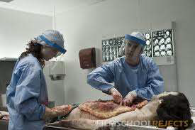
Science: Endeavors to understand and explain how the natural world works.
Science Is:
7. Classified into many different fields,
topics, or categories for specialized
study.
8. Different fields that overlap and
depend on each other for further
knowledge and
explanations.

Slide 5
Science: Endeavors to understand and explain how the natural world works.
Science Is:
9. A vast body of knowledge that is
always changing and expanding;
but it does have limitations.
10. Objective, unbiased, and
impartial—
or it should be.

Slide 6
Science: Endeavors to understand and explain how the natural world works.
Science Is Not:
1. A rigid collection of facts that are
inflexible.
2. Able to explain the answer to every
question, some phenomena are
not scientifically testable.
3. Unorganized, unrelated, or untestable

Slide 7
Science: Endeavors to understand and explain how the natural world works.
Science Is Not:
4. Based on that which cannot be observed,
measured, or outside of our senses to be
perceived.
5. Only based on one disciple, field, or topic
of knowledge.
6. Subjective, biased, or partial—
or it should not be.

Slide 8
C. Science Explanations: Hypothesis, Theory, or Law?
Hypothesis:
an educated
guess, based
on observation.
Theory: summarizes a hypothesis or group of hypotheses that have been supported with repeated testing over a wide variety of conditions over time.
Law: generalizes a
body of observations
that can be used to
describe or predict
something that is
universally
understood in nature.

Slide 9
Hypothesis, Theory, or Law?
Hypothesis:
Can be given as an explanation for the occurrence of an event
Can be a presumption to guide an investigation
Should be based on some knowledge or research
Must try to answer a scientific question

Slide 10
Hypothesis, Theory, or Law?
A hypothesis can be proven wrong, it doesn’t have to be right --a wrong a hypothesis only leads to another hypothesis
--a better product, a better clue, a better suspect
Should be stated in such a way that the experiment will collect measureable/ quantified data if possible.
Hypothesis:
Must be testable by known scientific methods.
Can be supported or refuted through further observation or experimentation.

Slide 11
Hypothesis, Theory, or Law?
Can be used as principles of explanation and prediction for a group of phenomenon.
Theories are well-established and highly reliable.
Theory: A theory is valid as long as there is no evidence to dispute it.

Slide 12
Hypothesis, Theory, or Law?
Theories can be disproven, modified, or changed with new scientific knowledge, observations, and technology.
Theory:

Slide 13
Hypothesis, Theory, or Law?
At the time that it is made, no exceptions have ever been found in a law.
Laws never explain “why” something happens, only that it will always happen the same way with no exceptions.
Law:

Slide 14
Hypothesis, Theory, or Law?
Example: Newton’s Law of Gravity—could be used to predict the behavior of a dropped object, but it could not explain why it happened.
Theories explain the “why” something happens, laws predict that it will always happen the same way.
Law:

Slide 15
CONPITT
6 Criteria of Science
Consistent
Observable
Natural
Predictable
Testable
Tentative

Slide 16
Non-Science: An area of science that does not meet the criteria of science.
Non-science areas may be very logical and based on good reasoning, but do not fall in the realm of true science.
Examples:
Belief Systems
Philosophy
Personal Opinions
Ethics
Sense of Esthetics

Slide 17
Scientific Method: An established method of research….a process to collect and evaluate information with objectivity.
1. Asking or defining a question
2. Researching the question
3. Forming a hypothesis
4. Developing and performing the experiment
5. Collecting the data
6. Analyzing the data
7. Writing the conclusion
8. Communicating the results

Slide 18
Forming a Hypothesis
*Hypothesis should be in the form of a statement, not a question.
*Hypothesis must be researched before it’s stated (why it’s an educated guess).
*The hypothesis must be testable; if it is not, it is not a valid hypothesis.
*The hypothesis must allow for a variable to be tested and what results are expected.
*Null hypothesis: what the researcher is seeking to disprove.
!

Slide 19

Designing the Experiment
The experiment either supports or disproves the hypothesis.
The experiment will be retested to validate the results.
The experiment must test the hypothesis.
The experiment should have planned steps for implementation.
Should only have one variable that is tested.

Slide 20

Types of Variables:
Independent variable : is the one factor that is changed, or the one factor that is different between the groups.
--one factor is best, so you can depend on your results, but in criminal case all the variables cannot always be controlled or minimized.
Dependent variable: is the variable that is observed, to see whether it is affected by the independent variable --this is normally the data that is collected as the experiment progresses.
.
Controlled variables:
(often called constants or controls) are things that could change in the experiment, but should be kept constant or unchanging. If these change then you have more than one independent variable and your data collected/results may not be valid.

Slide 21

Contributions of Science
The criminal justice system has been tremendously impacted by growing scientific knowledge and technological innovations
Explaining the natural world is a shared quest.
Scientific theories have limitations and can change over time.
Scientific knowledge is the most reliable knowledge we have.

