Slide 1
Crime Statistics
United states 2009 - 2013

Slide 2
United States – 2011
Population - 311,000,000
Adults in Prison
Adults on Probation
2,266,800
.7% of total population
4,814,200
1.5% of total population

Slide 3
United States - 2010
70,792 Juveniles in Detention

Slide 4
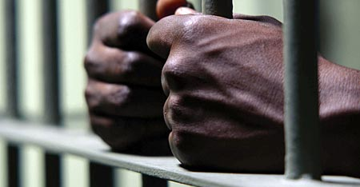
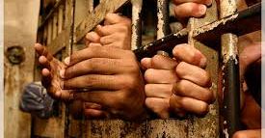

United States – 2010
Total Prison Population – 1,612,395
Blacks in Prison
Hispanics in Prison
Whites in Prison
39.4%
38.9 Million
20.6%
50.5 Million
40%
223.6 Million

Slide 5
United States - 2009
113,462 Women Serving Time in Prison or Jail

Slide 6
United States – 2013
Males Arrested by Age 18
Black Males – 30%
White Males – 22%
Hispanic Males – 26%

Slide 7
United States – 2013
Males Arrested by Age 23
Black Males – 49%
White Males – 38%
Hispanic Males – 44%

Slide 8
Police Officer Deaths - 2013
105 Officers Killed in the Line of Duty
- 101 Males
- 4 Females
Federal Officers – 11
Texas Officers – 13
California - 10

